Slide 1
PROJECT: AUTOMOBILE MARKET ANALYSIS
COMPLETED BY: MANDAR MALEWAR
MENTORED BY: JAYA PANDEY

Slide 2
Introduction
In the automotive industry, a car manufacturer faces a shifting market where drivers are becoming increasingly eco-conscious, prioritizing fuel efficiency and safety alongside performance. Data analytics is now applied at every stage of production.
The task is to refer to a car dataset, identify the potential models to launch, and present insights about the most diverse car manufacturer in the given country. To arrive at a conclusion, the upcoming tasks need to be performed.

Slide 3
Objectives
Objective 1- To analyze a car dataset to identify key factors for potential car models to be launched.
Objective 2- Extract actionable insights from the given data, focusing on key areas such as new product development, innovation, competitive analysis, or benchmarking.
Objective 3- Utilize the analytical skills acquired in previous sprints for this project, employing Excel as needed for the analysis requirements.
Objective 4- The objective of this sprint is to clean the dataset (if required), perform the project tasks to identify the potential model, and present insights about the most diverse car manufacturer in the given country.

Slide 4
Analysis
Business Question 1
Business Question 2
Sl. No. | Make | Model | ARAI_Certified_Mileage
1 | Suzuki | Dzire Tour | 28.4
2 | Suzuki | Dzire | 28.4
3 | Suzuki | Ciaz | 28.09
4 | Suzuki | Baleno | 27.39
5 | Tata | Tiago Nrg | 27.28
6 | Ford | Aspire | 26.1
7 | Ford | Figo | 25.5
8 | Hyundai | Aura | 25.4
9 | Hyundai | Xcent | 25.4
10 | Mahindra | Kuv100 Nxt | 25.32
Sl. No. | Make | Model | Displacement | ARAI_Certified_Mileage
1 | Suzuki | Dzire Tour | 1248 | 28.4
2 | Suzuki | Dzire | 1248 | 28.4
3 | Suzuki | Ciaz | 1248 | 28.09
4 | Suzuki | Baleno | 1248 | 27.39
5 | Tata | Tiago Nrg | 1047 | 27.28
6 | Suzuki | Ciaz | 1498 | 26.82
7 | Ford | Aspire | 1498 | 26.1
8 | Ford | Figo | 1498 | 25.5
9 | Hyundai | Aura | 1186 | 25.4
10 | Hyundai | Xcent | 1120 | 25.4
Interpretation-
Interpretation-
These are the top 10 cars with the highest ARAI Certified Mileage.
These are the top 10 cars with the highest ARAI Certified Mileage based on displacement.

Slide 5
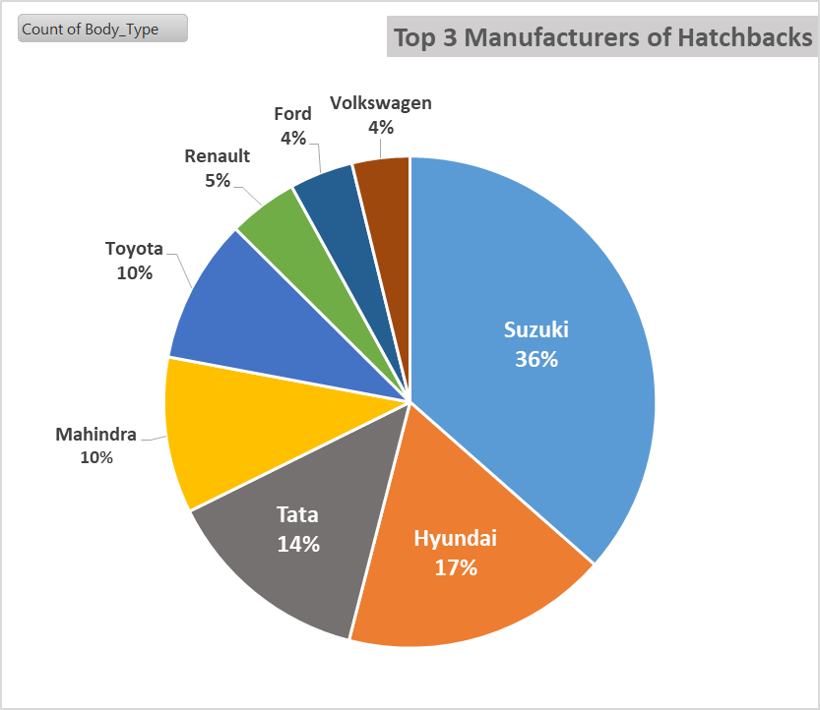
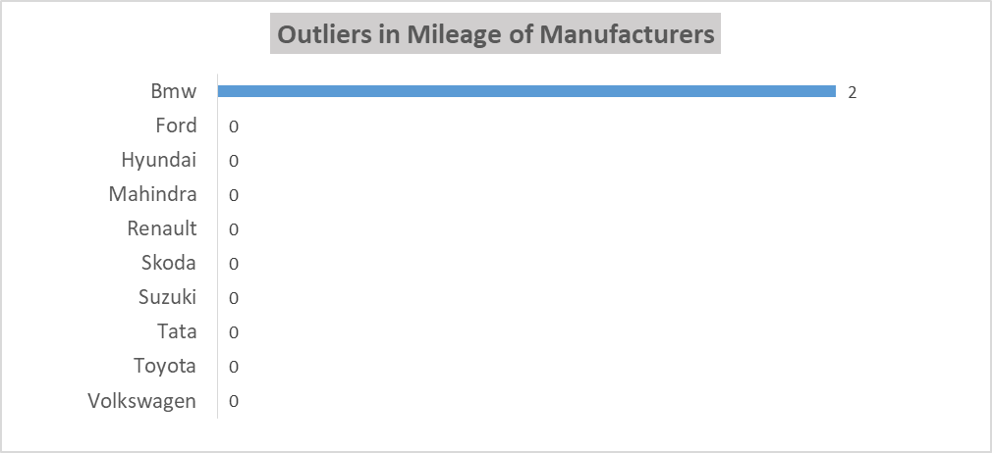
Analysis
Business Question 3
Business Question 4
Interpretation-
Interpretation-
The top 3 manufacturers with the highest number of cars of the hatchback body type are Suzuki, Hyundai and Tata.
There are only 2 outliers in Bmw mileage numbers and all others have 0 outliers.

Slide 6
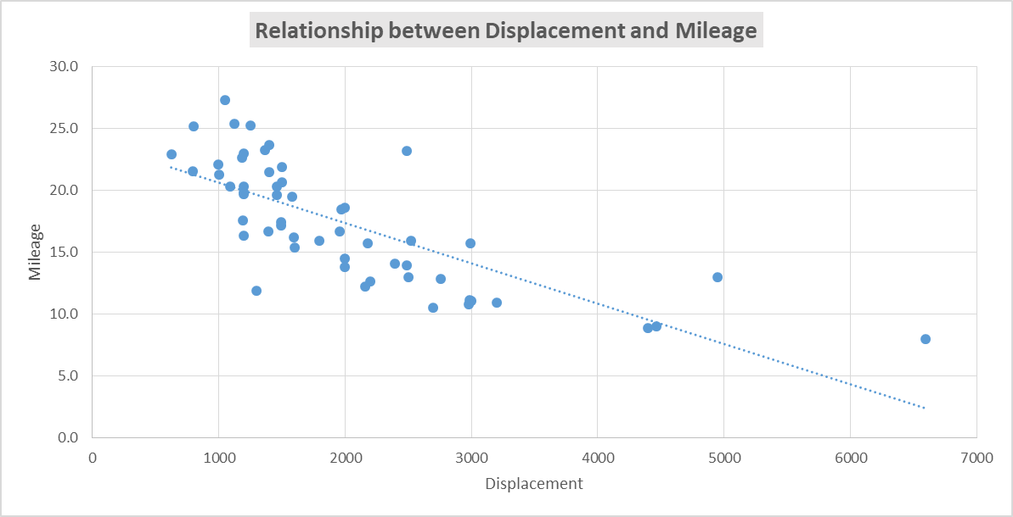
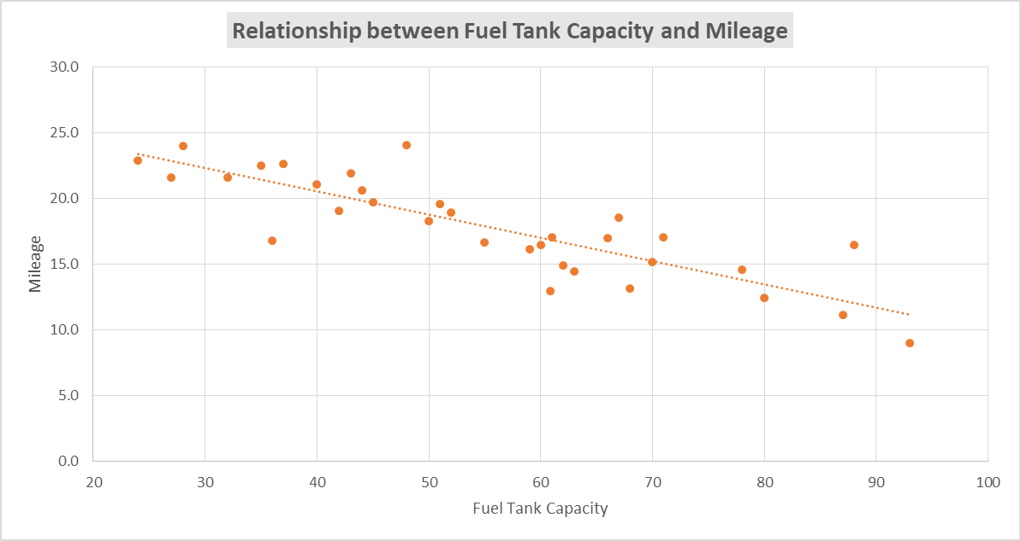
Analysis
Business Question 5
R= -0.749
R= -0.85
Interpretation-
There is strong negative correlation between Displacement and Mileage meaning the higher the displacement of the car, the lower the mileage is likely to be.
There is strong negative correlation between Fuel Tank Capacity and Mileage meaning that cars with lower mileage need/have higher fuel tank capacity to increase their tankful range.

Slide 7
Analysis
Business Question 6
Business Question 7
Sl. No. | Make | Model | Power | Torque | Ground_ Clearance | ABS | Number_of_Airbags | EBD
1 | Bmw | X4 | 265 | 620 | 498 | Yes | 6 | Yes
2 | Toyota | Land Cruiser | 265 | 650 | 225 | Yes | 8 | Yes
3 | Bmw | 7-Series | 609 | 850 | 152 | Yes | 8 | Yes
4 | Bmw | 7-Series | 265 | 620 | 152 | Yes | 8 | Yes
5 | Bmw | 7-Series | 265 | 620 | 152 | Yes | 8 | Yes
6 | Bmw | 7-Series | 265 | 620 | 152 | Yes | 8 | Yes
7 | Bmw | 6-Series | 265 | 620 | 152 | Yes | 6 | Yes
8 | Bmw | 6-Series | 265 | 620 | 152 | Yes | 6 | Yes
Make | Model | ARAI Certified Mileage | Body Type | Ground Clearance | ABS | Number of Airbags | EBD | Child Safety Locks | Sun Visor | Audio system
Ford | Ecosport | 23 | SUV | 200 | Yes | 6 | Yes | Yes | Driver & Front Passenger | CD/MP3/DVD Player with USB & Aux-in
Interpretation-
Interpretation-
The car best for family use is Ford Ecosport, an SUV with length of 3998mm and ground clearance of 200mm. It has ABS, EBD, child safety locks and 6 airbags keeping the passengers and kids safe at all times. It has an excellent mileage of 23 km/l and comes equipped with robust audio system (CD/MP3/DVD Player with USB & Aux-in) and sunvisors for both front passengers which make the long family drives enjoyable and comfortable.
The car best for adventurous drives is BMW X4 as it has the highest ground clearance of 498mm giving it go anywhere ability. It also has torque (620NM) which is needed for off-roading activities with ABS, EBD and 6 airbags which keep the passengers safe on their adventurous drives.

Slide 8
Analysis
Business Question 8
Make | Model | ARAI Certified Mileage | Body Type | Displacement | Length
Suzuki | Alto 800 Tour | 24.7 | Hatchback | 796 | 3395
Make | Model | ARAI Certified Mileage | Body Type | Ground Clearance | ABS | Number of Airbags | EBD | Child Safety Locks | Sun Visor | Audio system
Ford | Ecosport | 23 | SUV | 200 | Yes | 6 | Yes | Yes | Driver & Front Passenger | CD/MP3/DVD Player with USB & Aux-in
Interpretation-
The best compact car is Suzuki Alto 800 Tour as it has the highest mileage of 24.7 which is great for city driving. It is a hatchback which is short in length and fits in tight roads and places.
The car best for family use is Ford Ecosport, an SUV with length of 3998mm and ground clearance of 200mm. It has ABS, EBD, child safety locks and 6 airbags keeping the passengers and kids safe. It has an excellent mileage of 23 km/l.

Slide 9
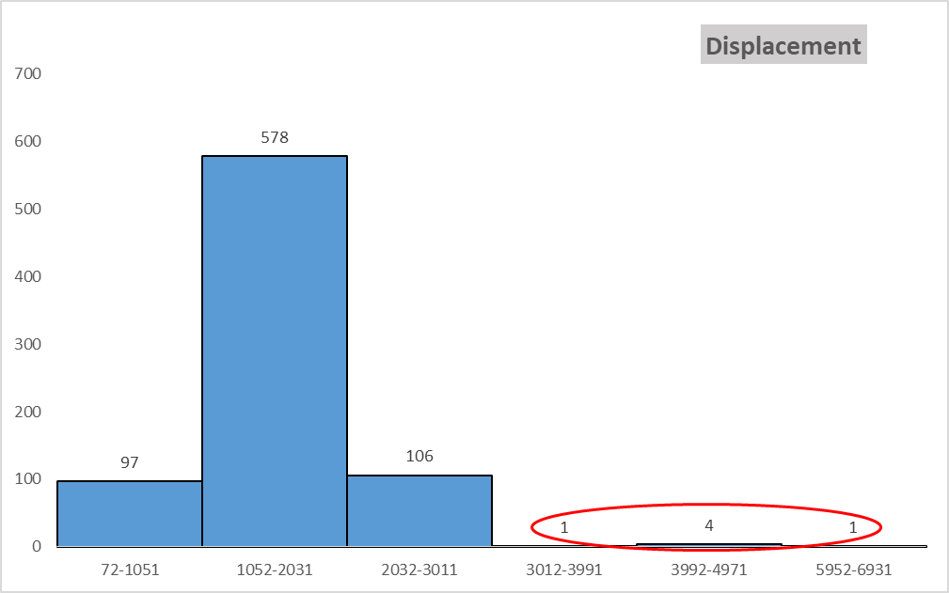
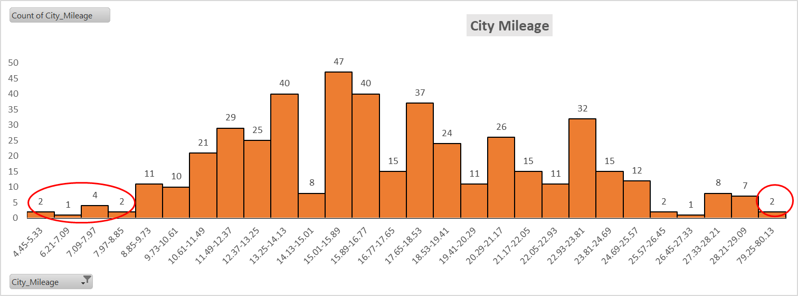
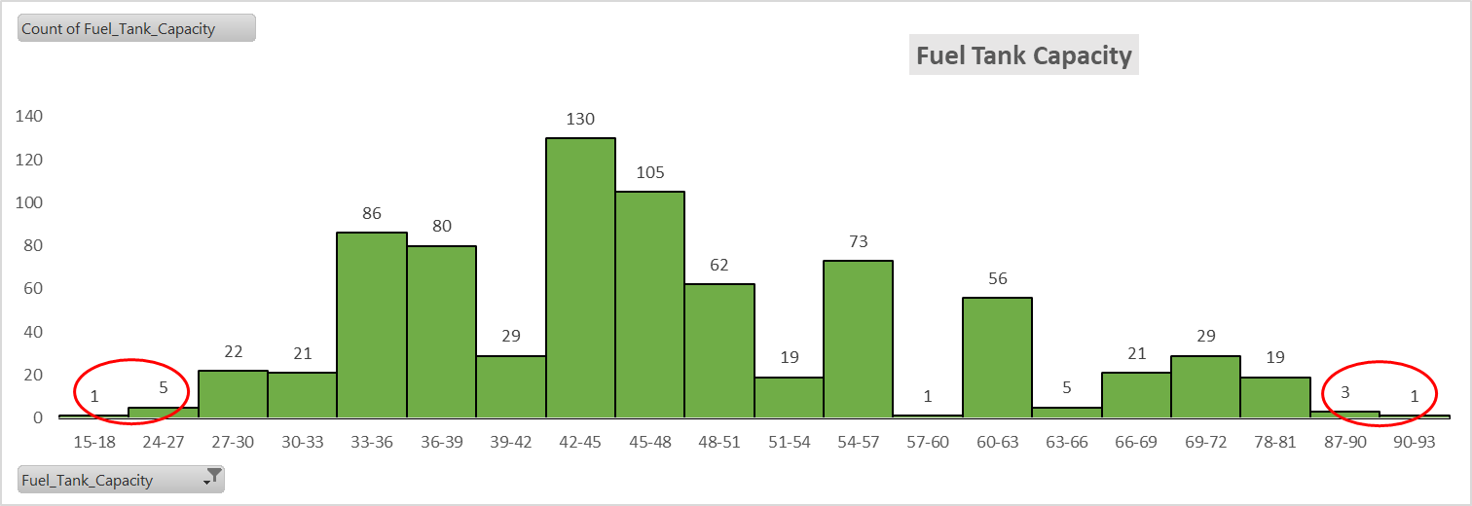
Analysis
Business Question 9
Interpretation-
6 outliers were found in the displacement histogram.
11 outliers were found in the city mileage histogram.
10 outliers were found in the fuel tank capacity histogram.
All the outliers were removed from the dataset.

Slide 10
Analysis
Business Question 10
Business Question 11
Body Type
Hatchback |  | Sedan |  | SUV
Make | Variant | Make | Variant | Make | Variant
Suzuki | 96 | Hyundai | 44 | Mahindra | 77
Hyundai | 46 | Skoda | 39 | Tata | 40
Tata | 36 | Toyota | 32 | Hyundai | 40
Mahindra | 27 | Suzuki | 31 | Ford | 15
Toyota | 25 | Volkswagen | 22 | Bmw | 14
Renault | 12 | Tata | 20 | Renault | 13
Ford | 11 | Bmw | 16 | Suzuki | 11
Volkswagen | 10 | Ford | 13 | Toyota | 9
 |  | Mahindra | 6 | Skoda | 4
 |  |  |  | Volkswagen | 2
Body Type | Total Nos.
Hatchback | 263
Sedan | 223
SUV | 223
MUV | 32
MPV | 25
Crossover | 10
Coupe | 3
Sports, Convertible | 2
SUV, Crossover | 2
Crossover, SUV | 2
Sedan, Coupe | 1
Interpretation-
Interpretation-
The top 3 car manufacturers with the highest number of variants have been marked above for every Body Type.
The most popular car body type, by count, is Hatchback (263).

Slide 11
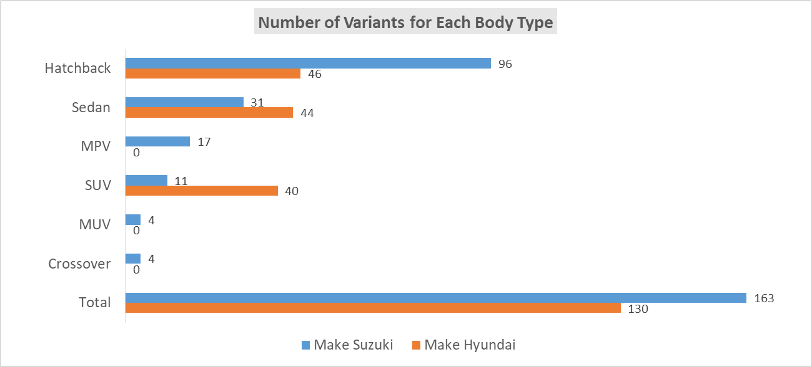
Analysis
Business Question 12
Business Question 13
Measures | Tata | Suzuki | Hyundai
Mean | 19.23 | 20.79 | 17.25
Variance | 21.51 | 22.67 | 12.75
Standard Deviation | 4.64 | 4.76 | 3.57
Coefficient of Variation | 24.11 | 22.90 | 20.71
Interpretation-
Interpretation-
The top 2 car manufacturers with the highest number of variants are- Suzuki(163) and Hyundai(130).
Suzuki offers the widest variation of city mileage (SD=4.76).

Slide 12
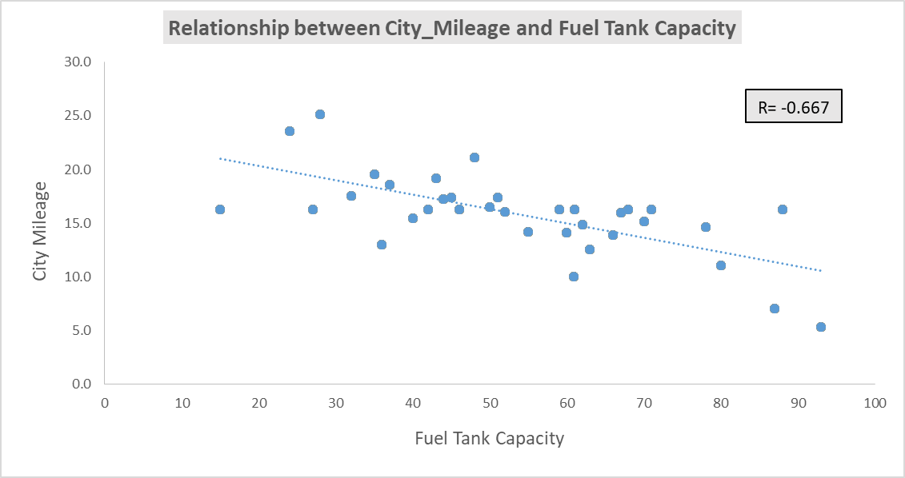
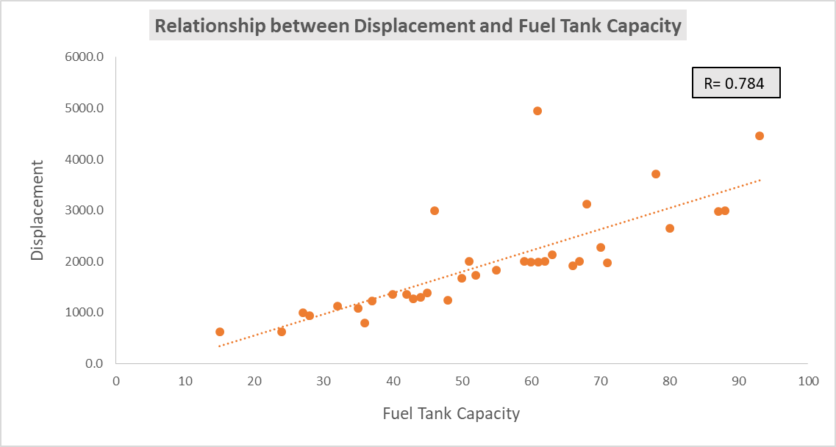
Analysis
Business Question 14
Interpretation-
There is strong negative correlation between City Mileage and Fuel Tank Capacity meaning higher the city mileage is of the car, the lower the fuel capacity it needs.
There is strong positive correlation between Displacement and Fuel Tank Capacity meaning that cars with higher displacement need/have higher fuel tank capacity to increase their tankful range.

Slide 13
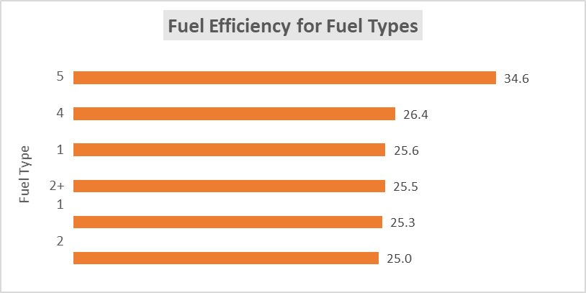
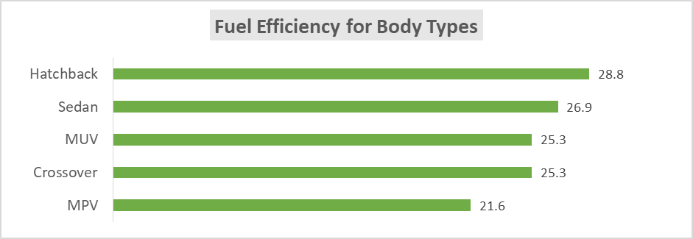
Analysis
Business Question 15
Interpretation-
Categorical data variables have been converted into numerical codes for easier analysis.
Average Combined Mileage has been calculated by combining city and highway mileages into a weighted average.
Distance (Range) has been calculated for each car's Fuel Tank Capacity based on its calculated Average Combined Mileage.
Business Question 16(A)
Interpretation-
Fuel efficiency across car makes and respective models, different fuel types and body types has been compared.

Slide 14
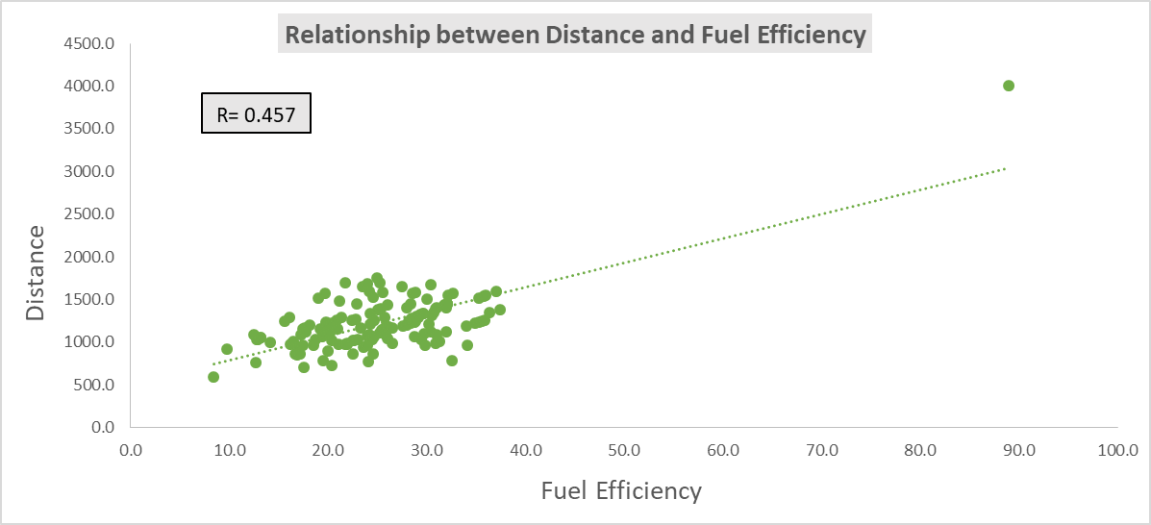
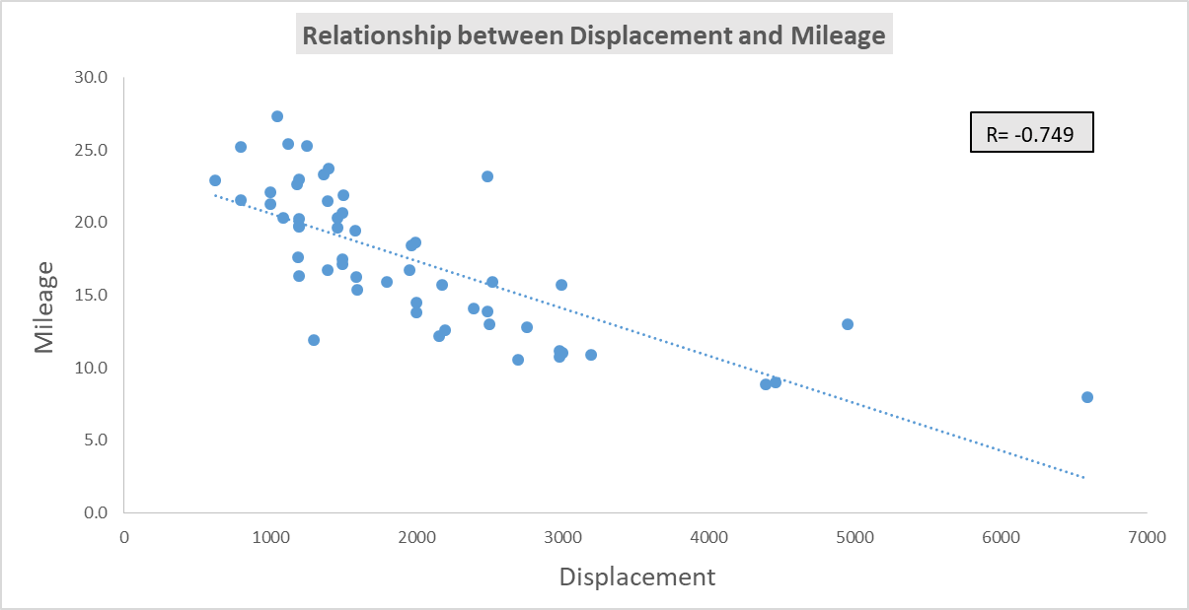
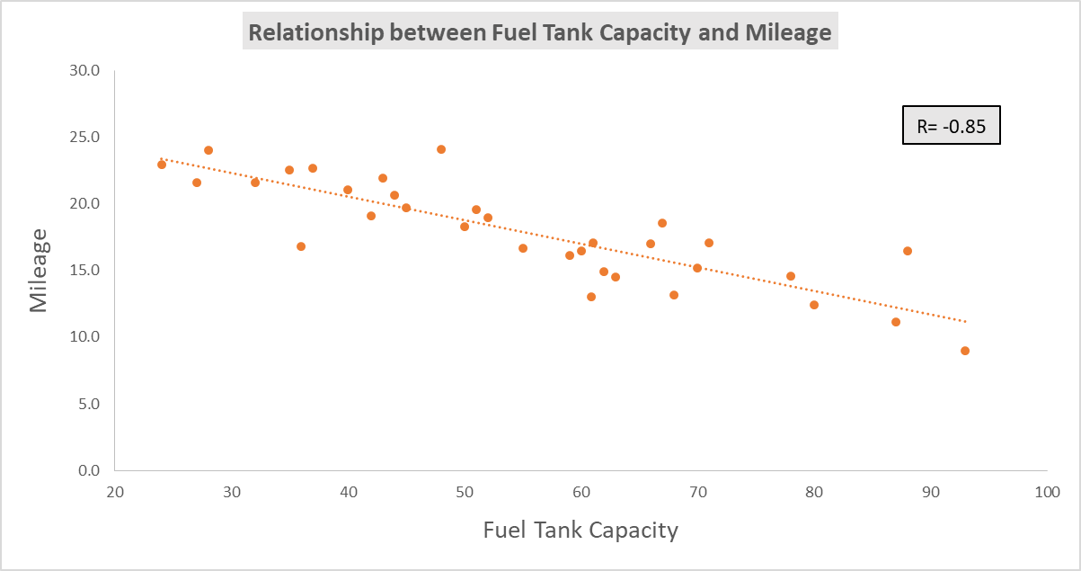
Analysis
Business Question 16(B)
Interpretation-
There is positive correlation between Distance and Fuel Efficiency meaning cars with higher fuel efficiency have higher distance/range.
There is strong negative correlation between Displacement and Mileage meaning the higher the displacement of the car, the lower the mileage.
There is strong negative correlation between Fuel Tank Capacity and Mileage meaning that cars with lower mileage need/have higher fuel tank capacity to increase their tankful range.

Slide 15
Analysis
Business Question 16(C)
 | Distribution of features within each fuel efficiency category
 | Low Efficiency (<18) | Moderate Efficiency (18-26) | High Efficiency (>26)
Fuel Type | Petrol/Diesel | Petrol/Diesel/CNG/ Hybrid/Electric/ Petrol+CNG | Petrol/Diesel/ Electric/ Petrol+CNG
Common characteristics of cars with high fuel efficiency
Petrol/Diesel/ Electric/Petrol+CNG | Audio System | Airbags
EBD | ABS | Sun Visor
Interpretation-
Cars have been segmented into 3 categories based on Fuel Efficiency- Low Efficiency(<18), Moderate Efficiency(18-26), High Efficiency(>26).
Distribution of features based on these categories have been done.
Common characteristics for cars in High Efficiency category have been identified.

Slide 16
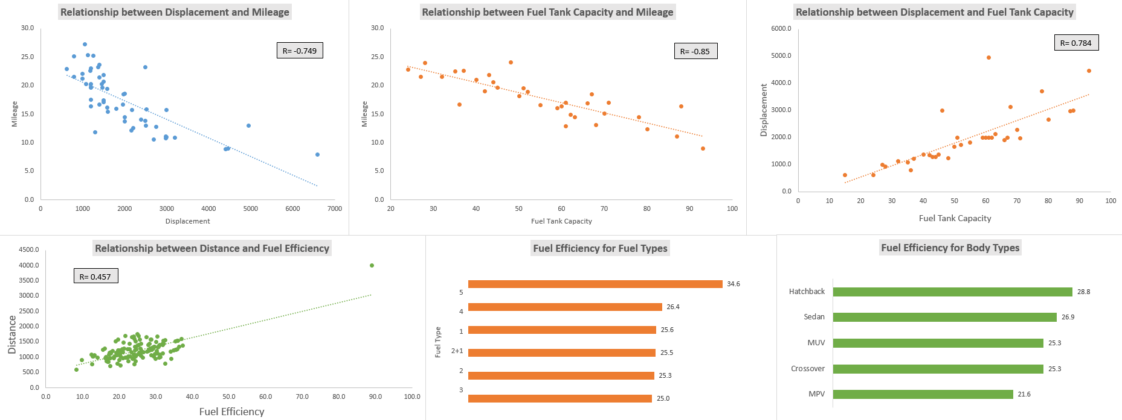
Analysis
Business Question 17

Slide 17
Summary
Following points are to be considered for potential car launches from manufacturer-
The lower the displacement of the car, the higher the mileage is likely to be. Manufacturer should keep the displacement of car small.
Cars with lower mileage and higher displacement need/have higher fuel tank capacity to increase their tankful range.
Cars with higher fuel efficiency have higher distance/range and need a smaller tank.
The most popular car body type, by count, is Hatchback (263). The manufacturer should consider launching hatchback primarily.
The best family car is Ford Ecosport, an SUV with length of 3998mm and ground clearance of 200mm. It has an mileage of 23 km/l and comes equipped with long safety and entertainment features list which make the long drives comfortable.
The best compact car is Suzuki Alto 800 Tour as it has the highest mileage of 24.7 which is great for city driving. It is a hatchback which is short in length and fits in tight roads and places.
The best car for adventurous drives is BMW X4 as it has the highest ground clearance of 498mm giving it go anywhere ability. It also has torque (620NM) which is needed for off-roading activities with ABS, EBD and 6 airbags which keep the passengers safe on their adventurous drives.
Cars have been segmented into 3 categories based on Fuel Efficiency- Low Efficiency(<18kmpl), Moderate Efficiency(18-26kmpl), High Efficiency(>26kmpl).

